Slide 1

TRAVEL BUDDY
-smart way to travel
Acropolis Institute of Technology and Research
Department of CSE
Project Coordinator and guide : Ms. Kavita Namdev
By-
Sajag Jain
Vaishnavi Bihare
Notes:
To use this title animation slide with a new image simply 1) move the top semi-transparent shape to the side, 2) delete placeholder image, 3) click on the picture icon to add a new picture, 4) Move semi-transparent shape back to original position, 5) Update text on slide.

Slide 2
WHY WE CHOOSE THIS PROJECT?
Travel is about exploring!
Problems in making travel plans
Complexity of arranging everything in one place
You may not know everything about a place
Its good to talk to someone who lives there
Hence TRAVEL BUDDY

Slide 3
INTRODUCTION
Travel Buddy is a customer facing app and is built to address common requirements of people during travel. This application will help users who love to explore new places. It provides user to search places on the basis of their choice and also make a bucket list. We provide a application with multiple features which allows them to view current news and weather forecast; also look out best time to visit places. It links user with top websites such as Goibibo, IRCTC so that user can directly book tickets, hotels and restaurants and also gives information about weather forecast. This application also provide ratings and reviews system for optimized user experience and provide travel guide per city. Ratings and reviews will help user to explore that place with enthusiasm.
Notes:
To use this title animation slide with a new image simply 1) move the top semi-transparent shape to the side, 2) delete placeholder image, 3) click on the picture icon to add a new picture, 4) Move semi-transparent shape back to original position, 5) Update text on slide.

Slide 4
AIM AND OBJECTIVE OF THE PROJECT
Following is the aim and objective which is to be accomplished:
AIM –
To provide user with an app which lets it do all the required work related to travel hassle free and provides necessary information about the place to make there travel a comfortable and effortless
OBJECTIVE –
To build an app which has all the required facilities and a interactive GUI to show every detail clear and concise.

Slide 5
SCOPE OF THE PROJECT
Scope
Focus
Performance
Keeping the main goal in mind.
Keeping in mind the performance with the amount of information displayed.
Baseline
Covering all the requirements and defining what is too much.

Slide 6
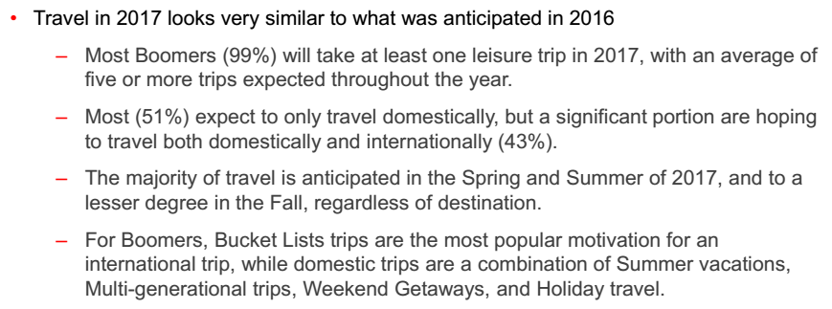
BACKGROUND
Travel application are
helpful to user, and many
of them are available
for free.
Applications such as:
GoIbibo
IRCTC Connect
Trip Advisor
Ixigo
Make My Trip
Because Its All About Travelling

Slide 7

TOOLS AND TECHNOLOGIES
JAVA
Java has huge open source support, with many libraries and tools available to make developers life easier.
Java protects you from many of the problems inherent in native code, like memory leaks, bad pointer usage, etc.
Java allows them to create sandbox applications, and create a better security model so that one bad App can't take down your entire OS.
ANDROID STUDIO
There are multiple ways to approach Android Development but by far the most official and powerful is to use Android Studio. This is the official IDE (Integrated Development Environment) for the Android platform, developed by Google and used to make the majority of the apps that you probably use on a daily basis.
XML- Extensible Markup Language
The advantage to declaring your UI in XML is that it enables you to better separate the presentation of your application from the code that controls its behavior.
Your UI descriptions are external to your application code, which means that you can modify or adapt it without having to modify your source code and recompile.

Slide 8
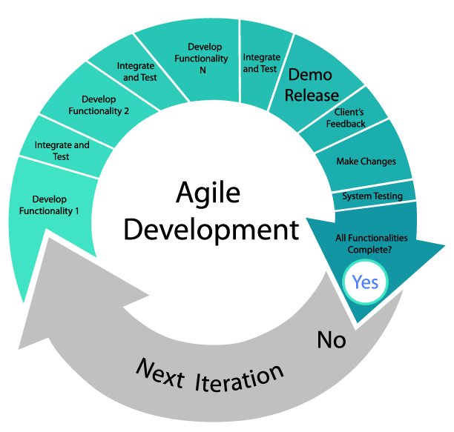
DEVELOPMENTMETHODOLOGY
Agile Methodology-collaborating to iteratively deliver whatever works
Individuals and interactions over processes and tools; Working software over comprehensive documentation; Collaboration over contract negotiation; Responding to change over following a plan.
It emphasizes adaptability to changing situations, adequate and ongoing communication among the project team and between them and the client. Agile methodologies are great to use in dynamic environments where there’s potential for changing or evolving requirements
Agile projects are characterized by a series of tasks that are conceived, executed and adapted as the situation demands, rather than a pre-planned process. Being agile helps teams respond to unpredictability through incremental, iterative work processes.

Slide 9
OUTPUT OF THE APPLICATION
1
2
3
4
5
General Information about the places with their respective weather forecast details.
Search Hotels, Flights, Buses, Trains, Cabs and Restaurants around it.
City Guide- to explore the place with a friend.
Rating and Reviews- Recent tweets about that place so a user can analyze it perfectly.
Login and sign-up for users.
Reference : The basics you can find anywhere 5 Steps To Successful Storytelling Published on April 5, 2014 Featured in: Marketing & Advertising

Slide 10
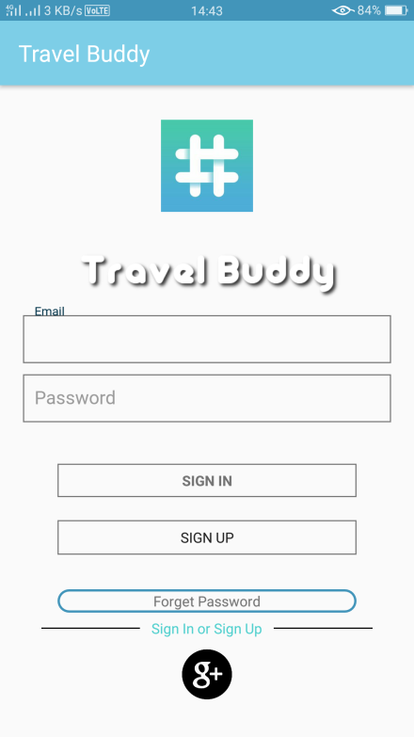
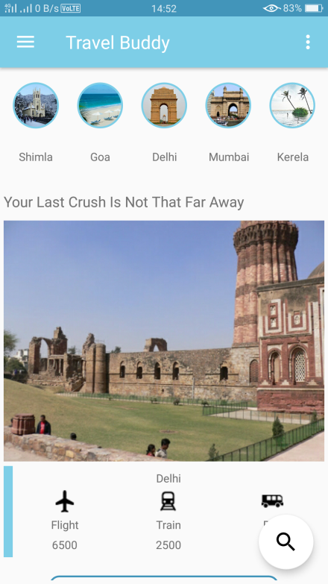
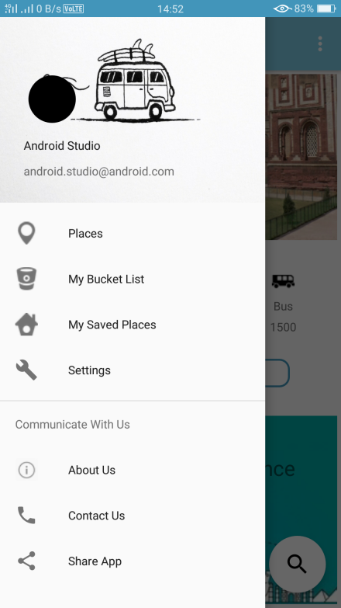
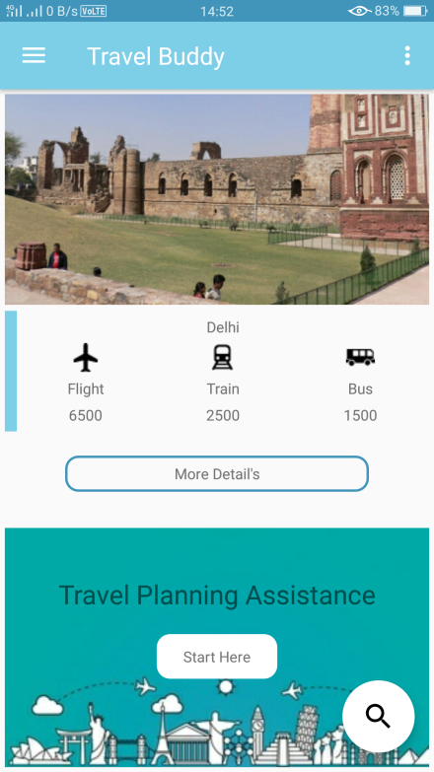
FINAL RESULT
The following screenshot’s shows look and feel of the application :
Login
Home
Navigation Drawer
Home Scrolled

Slide 11
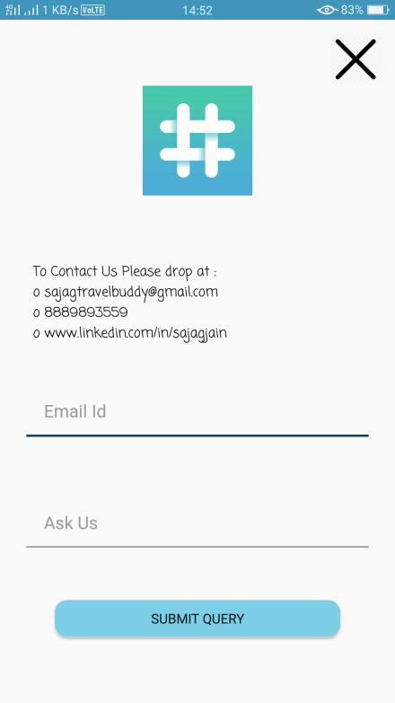
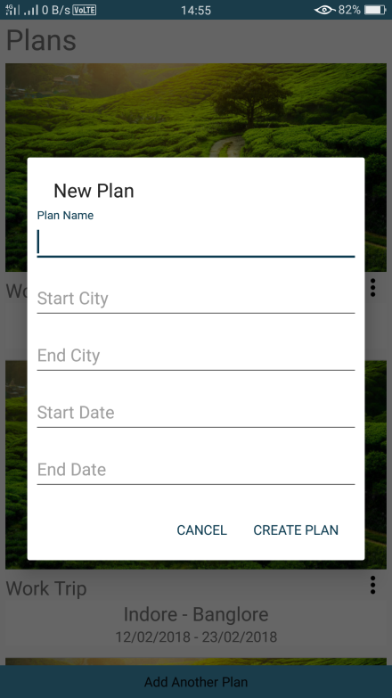
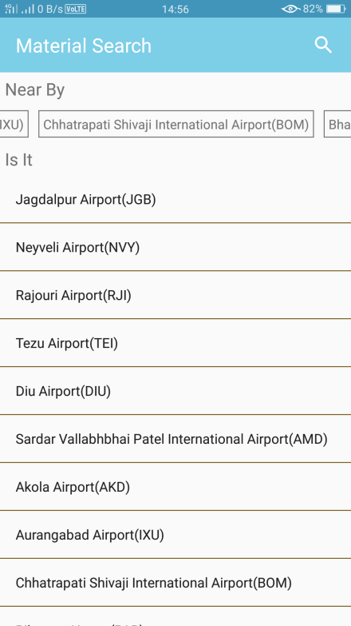
FINAL RESULT
The following screenshot’s shows look and feel of the application :
Contact Us
New Plan
Airport Search

Slide 12
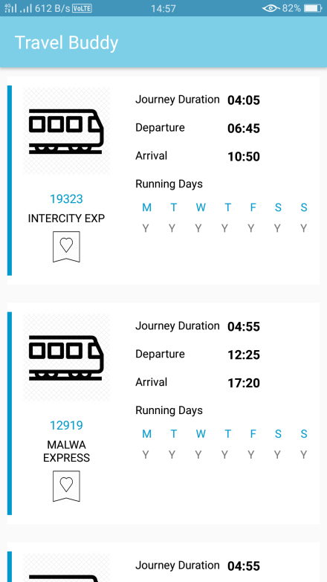
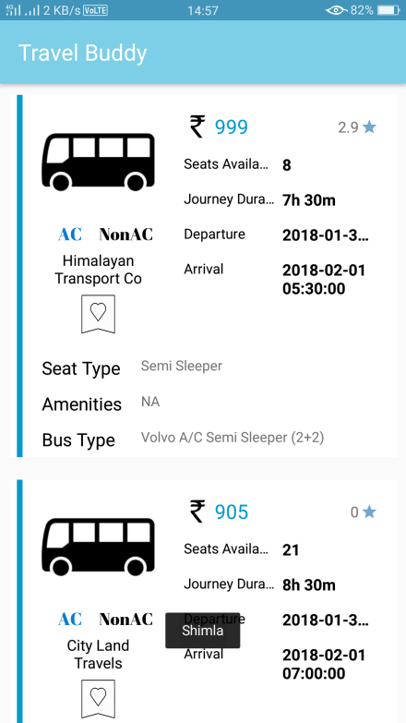
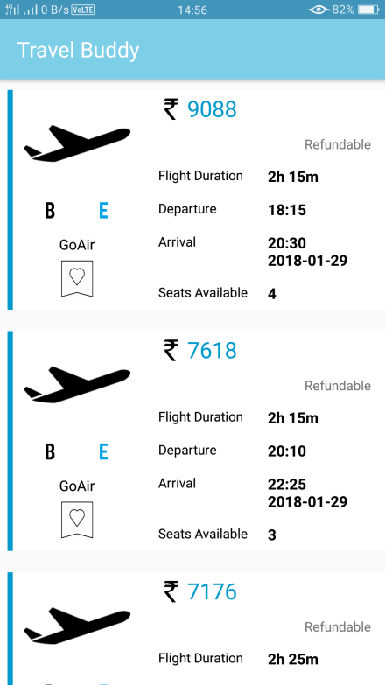
FINAL RESULT
The following screenshot’s shows look and feel of the application :
Trains
Buses
Flights

Slide 13
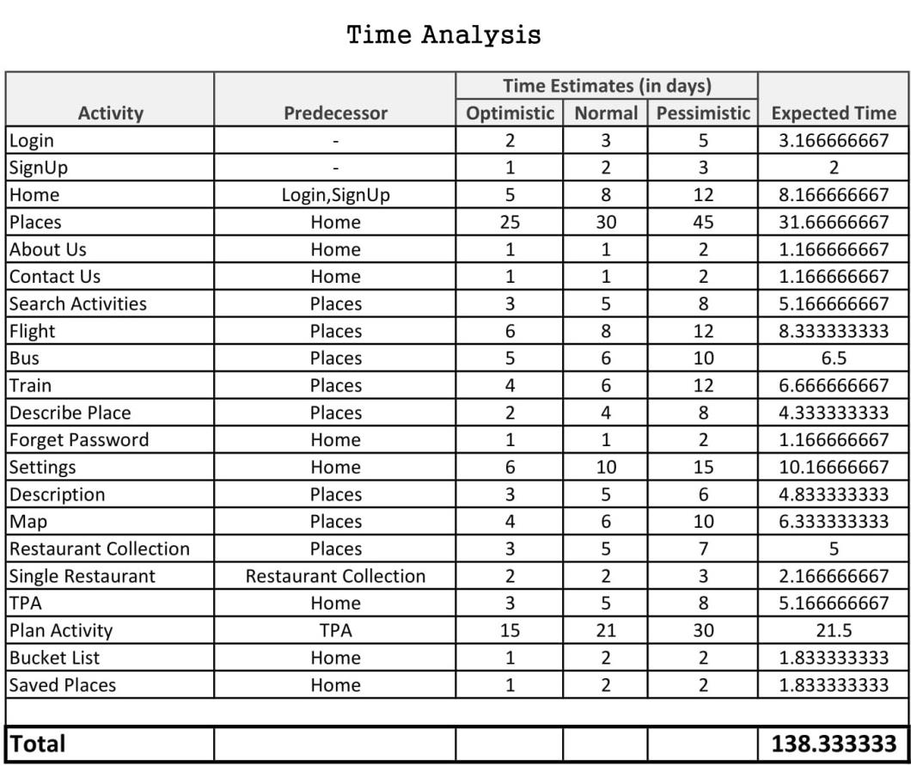
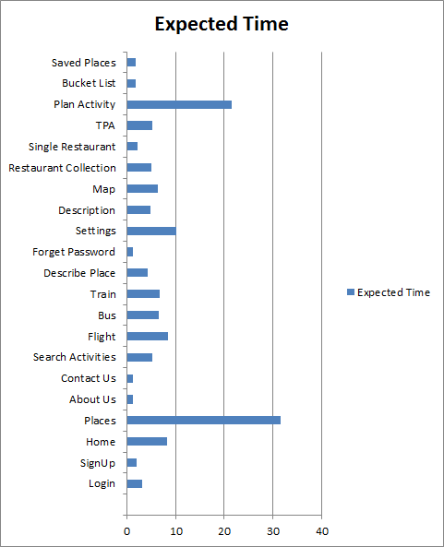
TIME ANALYSIS
138 Days is the time calculated by PERT Analysis

Slide 14
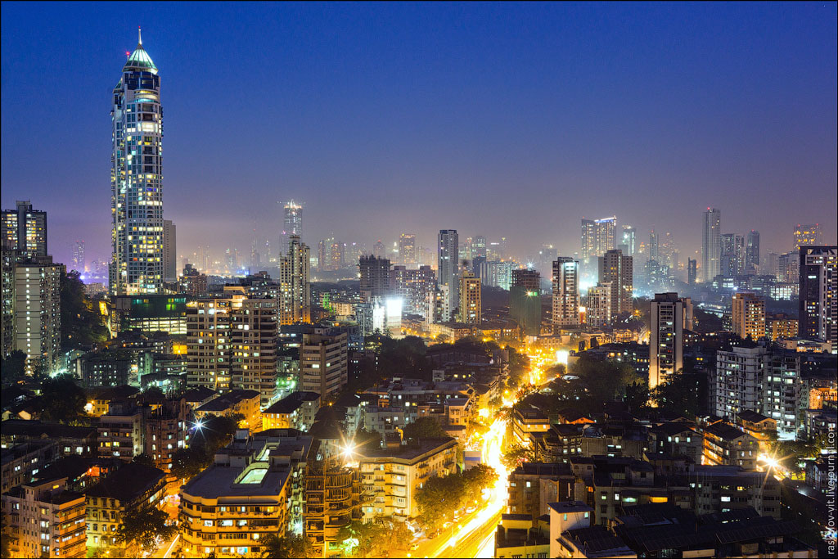
Project Application
Travel Planning Assistance:
The main and the most important feature of the application is travel planning assistance.
This feature will help user to make a systematic and well scheduled travel plan.
Information about the places:
This feature will help user to explore more. By giving general description about the place and adding your dream locations to your bucket list.
It will also give a briefing about a place and you can also share it with your friends.

Slide 15
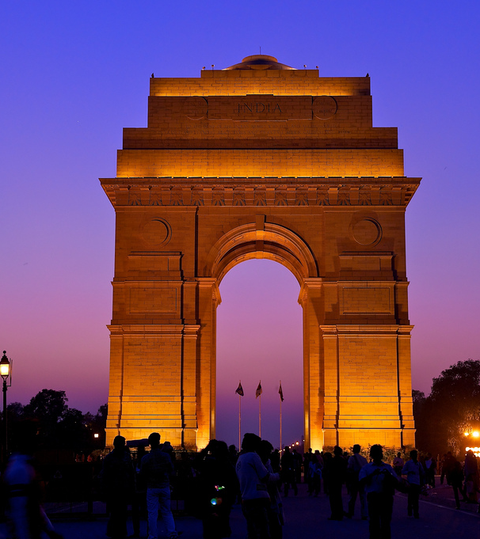
Project Application
Searching and Booking
Travel Buddy will help you to search Flights, Trains, Cabs around that place.
It was also provide you the poplar spots nearby to visit.
Helps you in searching Restaurants and hotels.
Ratings and Reviews
Recent Tweets about that place will help you to explore more.

Slide 16
Conclusion and Future Scope
Conclusion-
This is to conclude that the project that we undertook was worked upon with a sincere effort. Most of the requirements have been fulfilled up to the mark and the requirements which have been remaining, can be completed with a short extension. This project would definitely satisfy all the requirements of the college and would be beneficial for the students and the college staff.
Future Scope-
Travel Buddy can help many explorers and travelers to plan their trip easily and has a world wide scope as it is implemented in different languages, hence people can connect through each other and explore new places.
Notes:
Tip:
When using complex image as full-bleed background add a transparency (70%-90%) fill layer to give contrast to text.

Slide 17
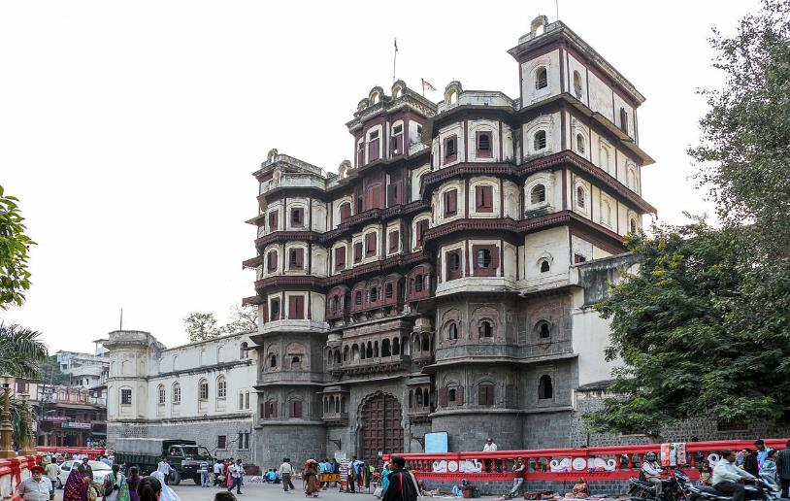
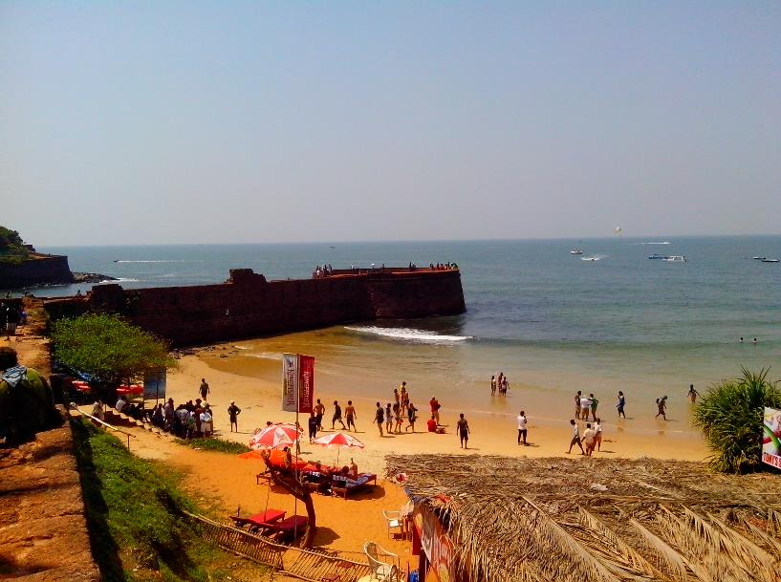
REFERENCES
Available at www.goibibo.com.
Available at www.programmerspoint.com.
Available at www.androidhive.com.
Available at https://en.wikipedia.org/wiki/Android.
Available at www.mygeekmonkey.com.
Available at www.technology.amis.nl
Available at www.mapmyindia.com
Available at www.newsapi.com.
Available at www.stackoverflow.com
We also thank our department for supporting us and giving us the required help.

Slide 18
TRAVEL -Before you run out of time!
THANK YOU

